Slide 1
Success Stories: changing occupations
Jean Pepper
DE Div. of Libraries

Slide 2
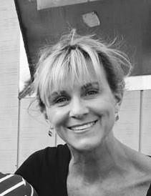
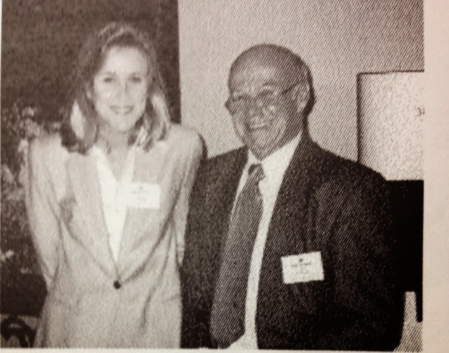
Beth’s Success Story

Slide 3
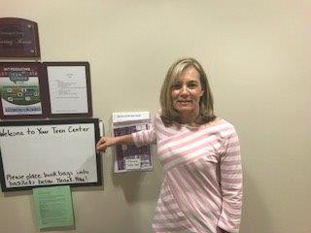
Susan’s success story

Slide 4
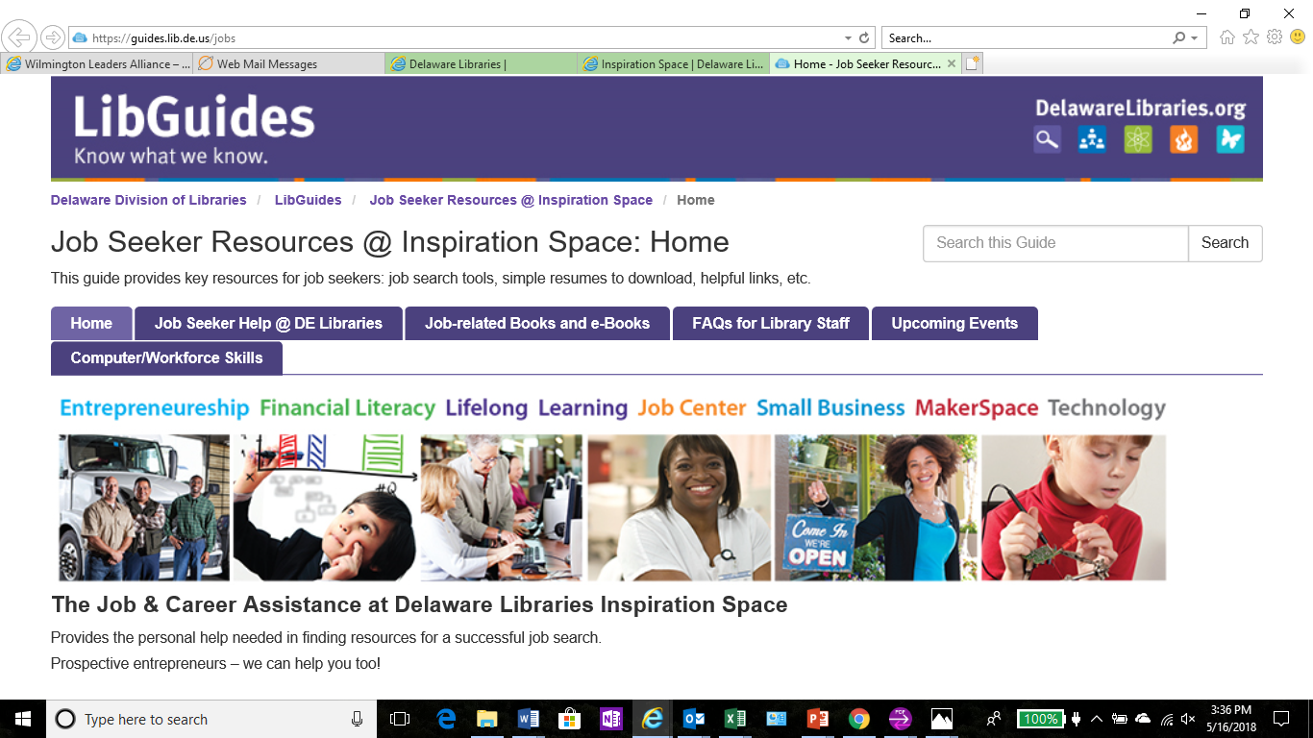
Take Aways
Link for job seekers: www.lib.de.us/is/jobs

Slide 5
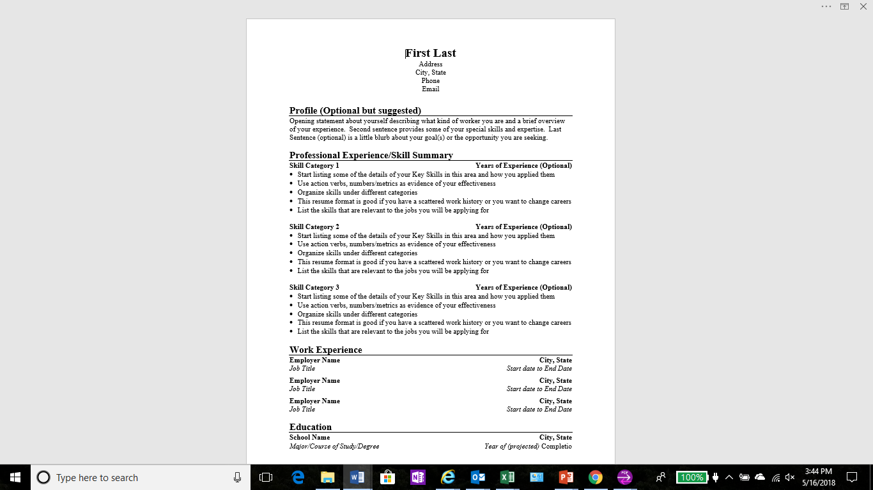
Take Aways
Use a functional resume: identify by skills
and not by job function

Slide 6
Take Aways
Resource Books from the Library @
https://guides.lib.de.us/c.php?g=605951&p=4204704

